Slide 1
ICT Academy Student Operation Guide— How to register, log in and change password How to associate to ICT Academy(ICT Academy Student) How to learn online How to apply for vouchers
July,2019

Slide 2
Contents
01
Guest visits ICT Academy homepage
02
How to register (not include existed accounts)
03
How to change password
04
How to associate to ICT Academy(ICT Academy Student)
05
How to enroll in class and learn online
06
How to apply for vouchers

Slide 3


Method one: ① Visit https://e.huawei.com/cn/talent/#/home ② Click “Partner →ICT Academy Introduction” to enter the ICT Academy homepage
01
Guest visits ICT Academy homepage
Method two： Visit www.huaweiacad.com to enter the ICT Academy homepage

Slide 4
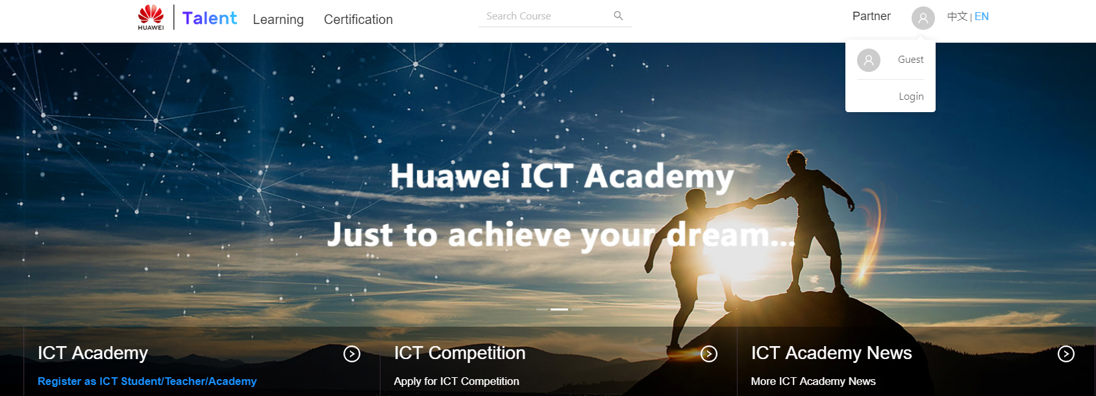
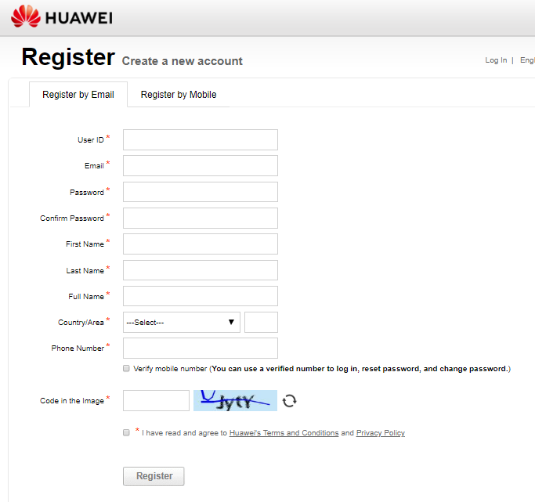
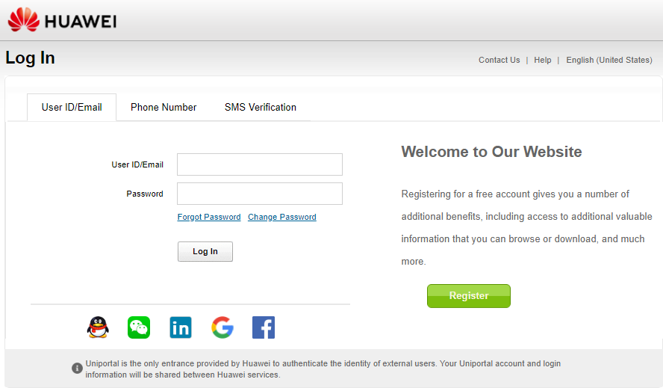
Click at the head image ——Login——Register——Complete the basic info and submit
02
How to register (not include existed accounts)
1
2
3

Slide 5
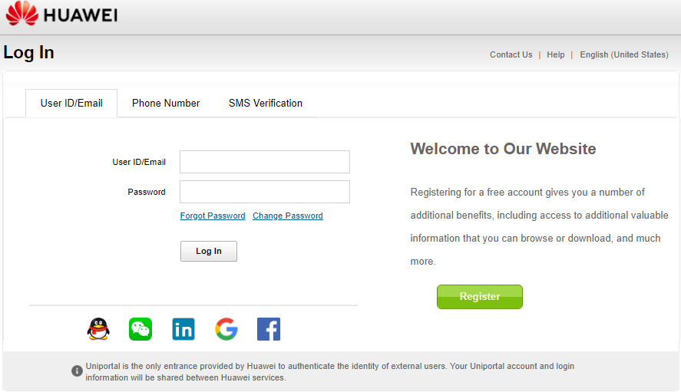
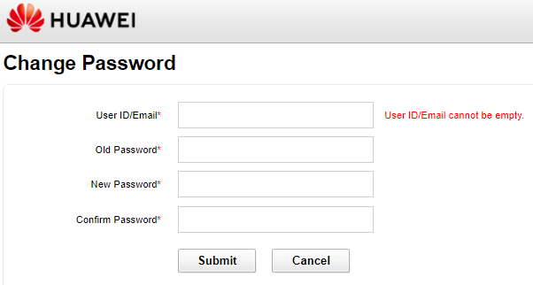
Go to the login page or click https://uniportal.huawei.com/uniportal Click Change Password-Reset and submit
03
How to change password

Slide 6
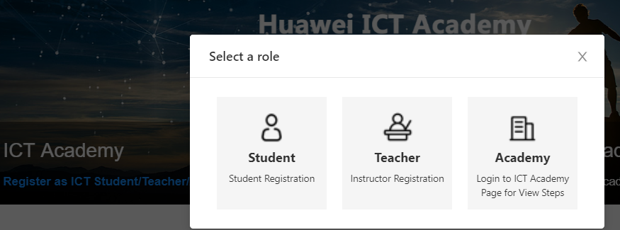
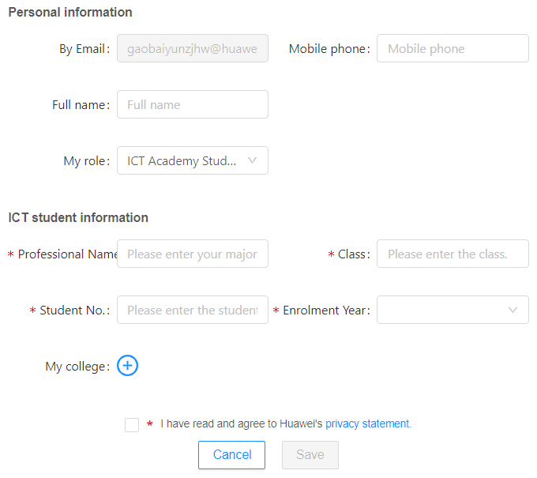
04
How to associate to ICT Academy(ICT Academy Student)
2
1
Go to the homepage and click “ICT Academy”—Student—Complete the basic info —Click “+” to choose your academy —Save—Waiting for approval（email）
Choose your academy
*Once approved, your registration will be done.
3

Slide 7

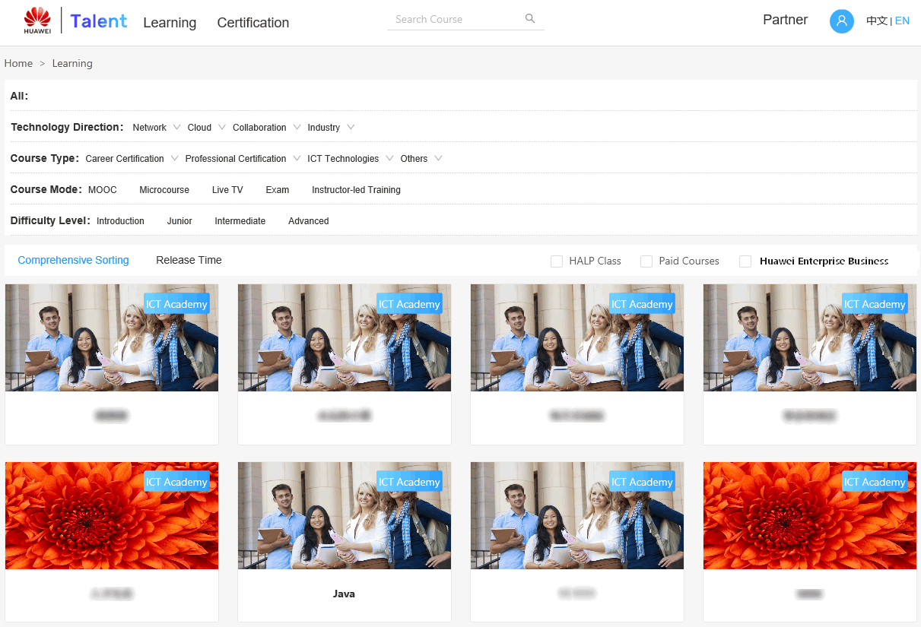
Go to the homepage and click “Learning”—Choose your course and click at the cover page
05
How to enroll in class and learn online

Slide 8
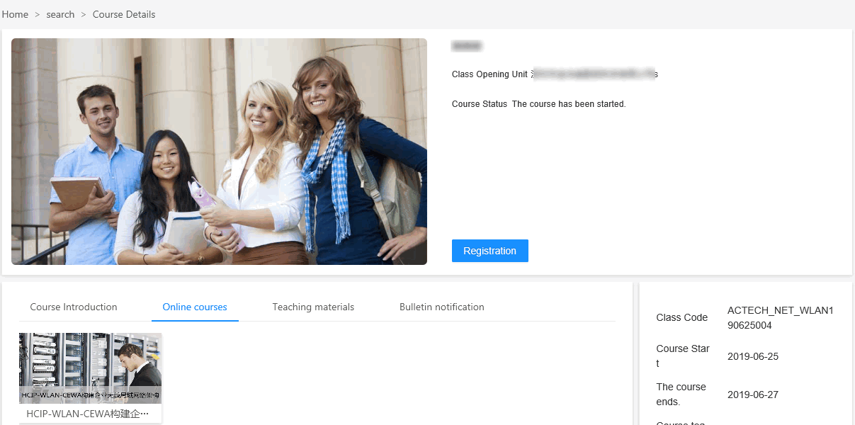
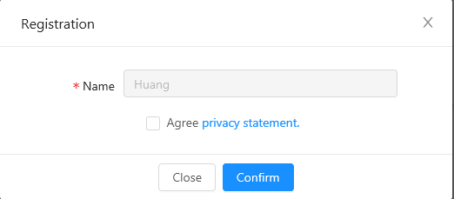
Registration-Tick the “privacy statement”-Confirm-Online Courses-Click the cover page to start study
05
How to enroll in class and learn online
2
1
3
4

Slide 9
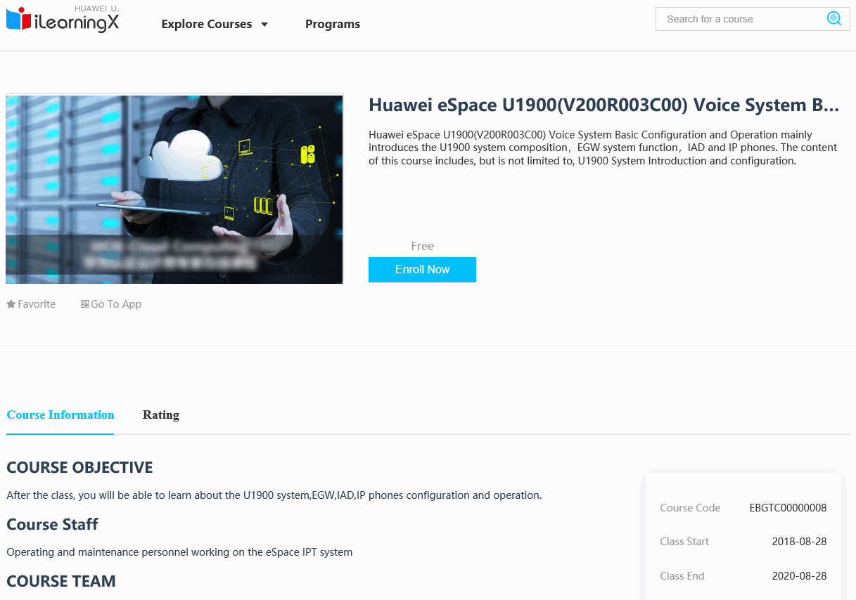

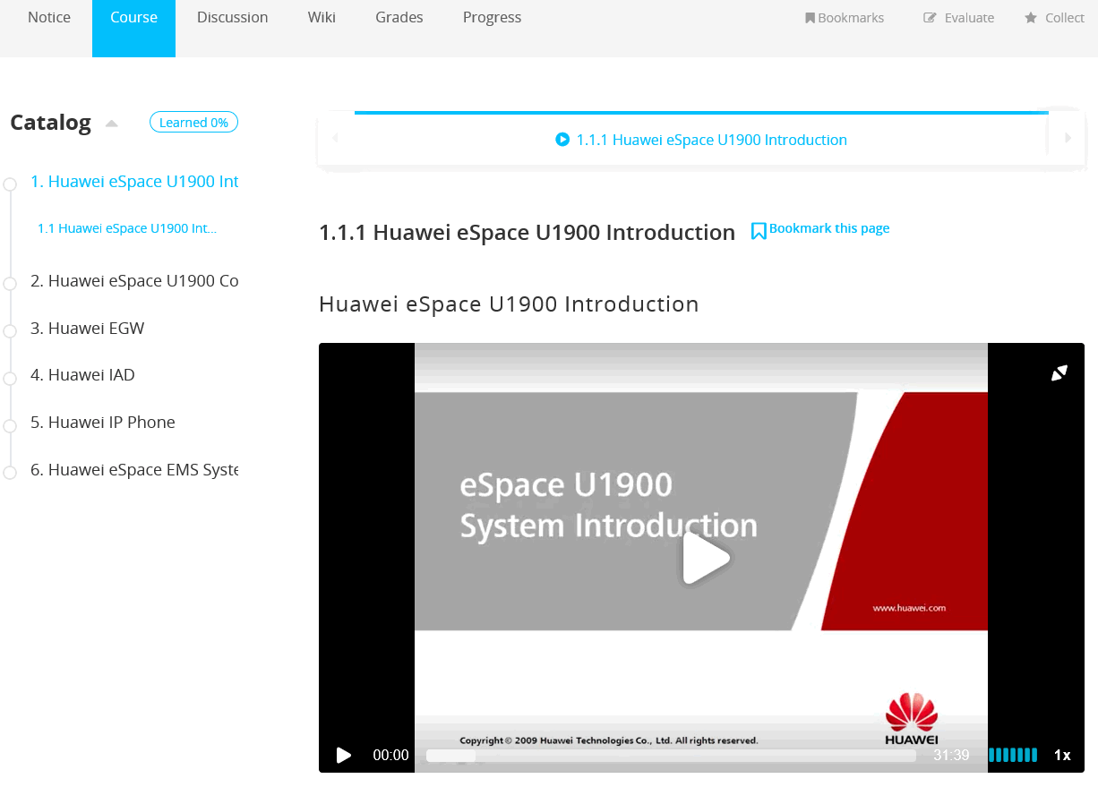
Enroll—View Course—Start learning
05
How to enroll in class and learn online
2
3
1

Slide 10

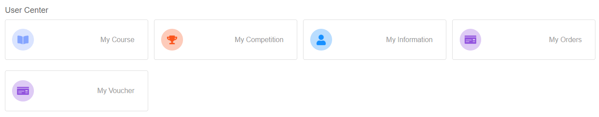
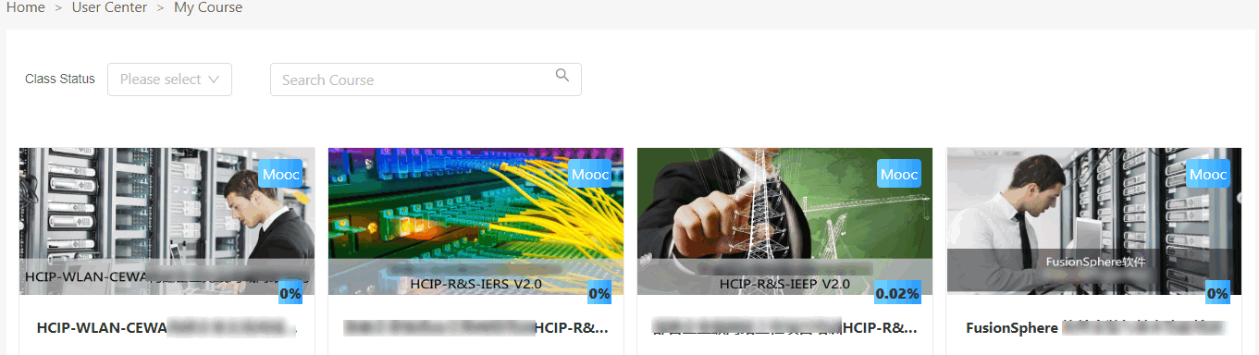
Click “My Course” to check the enrolled course list
05
How to enroll in class and learn online
1
2
3

Slide 11
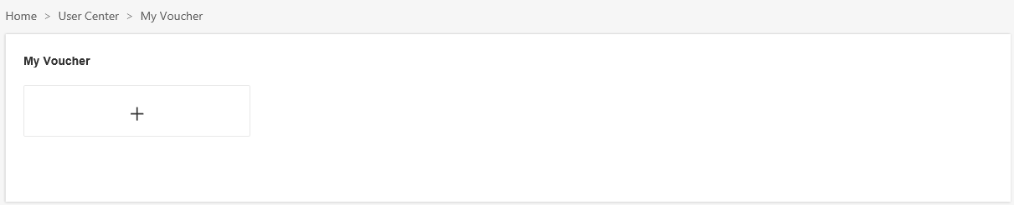
User Center——My Voucher——Apply for Vouchers
06
How to apply for vouchers
1
2
3

Slide 12
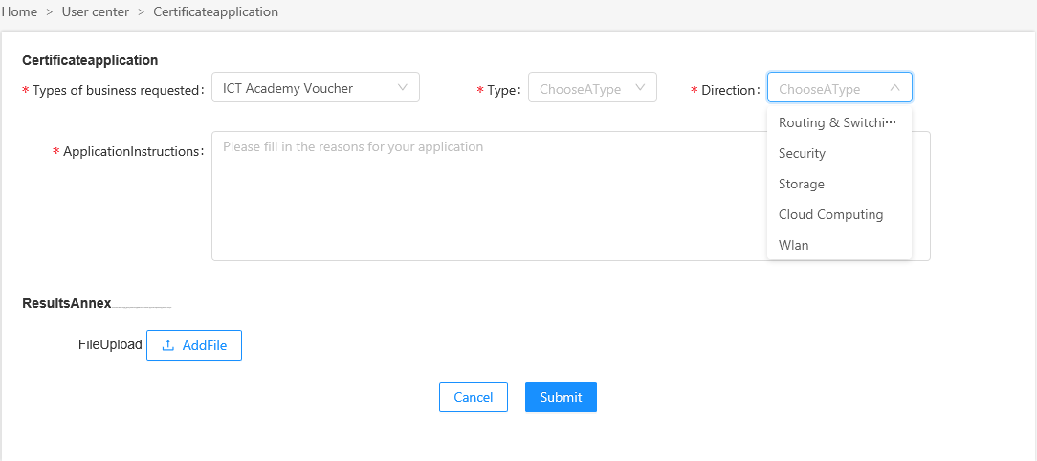
Fill in the application details —Submit—Wait for approval（email）
06
How to apply for vouchers
First application will not require to add

